Slide 1

HealthFit
Presented by Vishal Bajad
29th May 2023

Slide 2

"Take care of your body; it's the only place you have to live."
- Jim Rohn

Slide 3

Agenda
Project Goals and Objectives
Technical Details
Demo
Architecture
Future Scope
Project Components (Code Walkthrough)
Conclusion and Thanks you

Slide 4

Project Goals and Objectives
The system allows publishing and subscribing to Health Journals in a secure way. The system implements the following specifications.
For publishers
Web portal to upload and manage list of health and fitness Journals.
Supported format for health Journal – Pdf
For public users
Web portal to find and subscribe to health Journal.
Once subscribed the users are able to browse and read health Journals online.

Slide 5

Technical Details
Framework
Front End : .NET Razor Pages
Back End Service : .NET 7 Web API
Database : SQL Server
Design Pattern : Repository Pattern

Slide 6
Technical Details
Security
Salt and hashed password stored in database
AntiForgeryToken
Client side as well as Server side validation
URL Encoding
JWT Authentication for APIs
Used HTTPS for secure connection
Sanitize File Names before uploading
Secured File Upload Endpoint with JWT
Separate file storage location with Secure with Token
File Upload Rate Limiting

Slide 7
Demo (Screen walkthrough)

Slide 8

Dashboard Screen

Slide 9
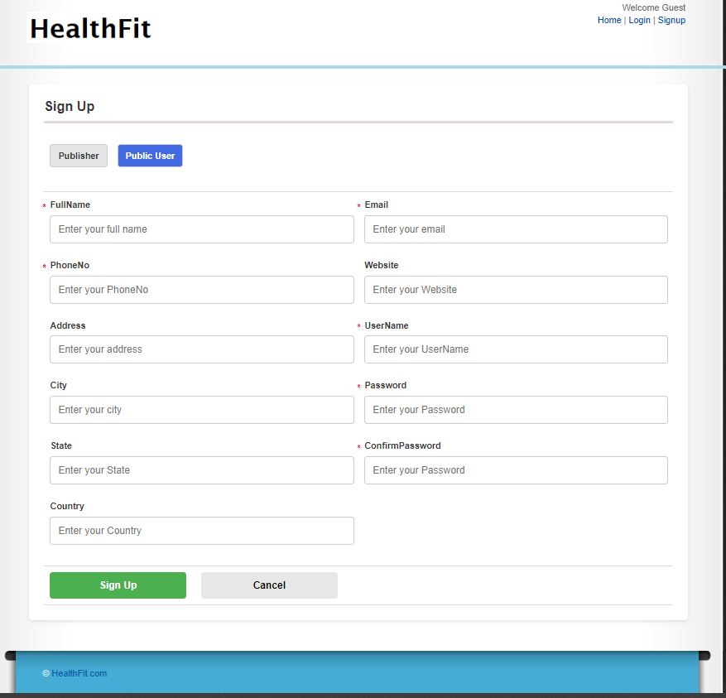
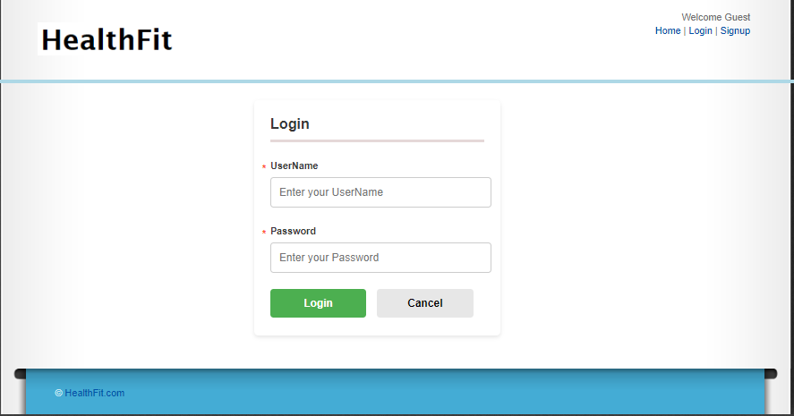
Signup and Login Screen

Slide 10
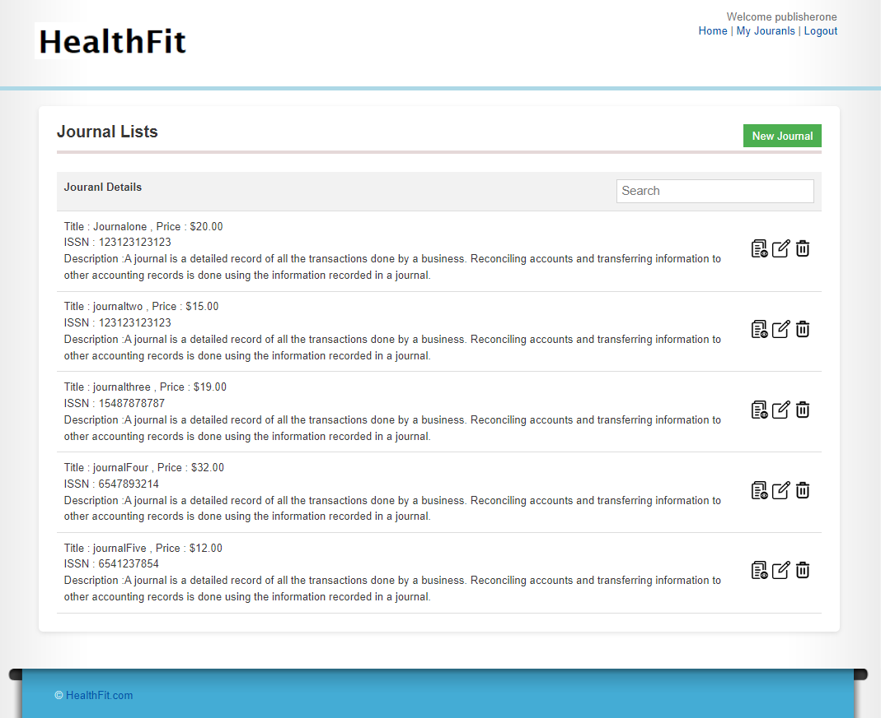
Publisher ->
My Jornals

Slide 11
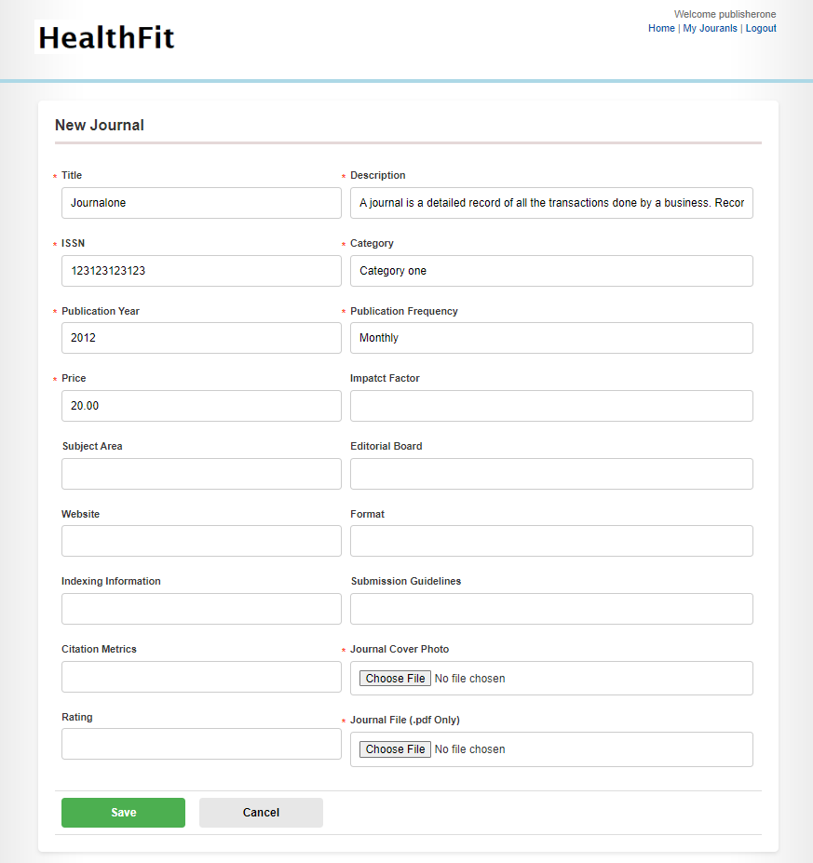
Publisher ->
New /Edit Jornals

Slide 12

Public User ->
Dashboard

Slide 13

Public User -> Subscribe
Page

Slide 14

Publisher/User ->
View Jornals

Slide 15
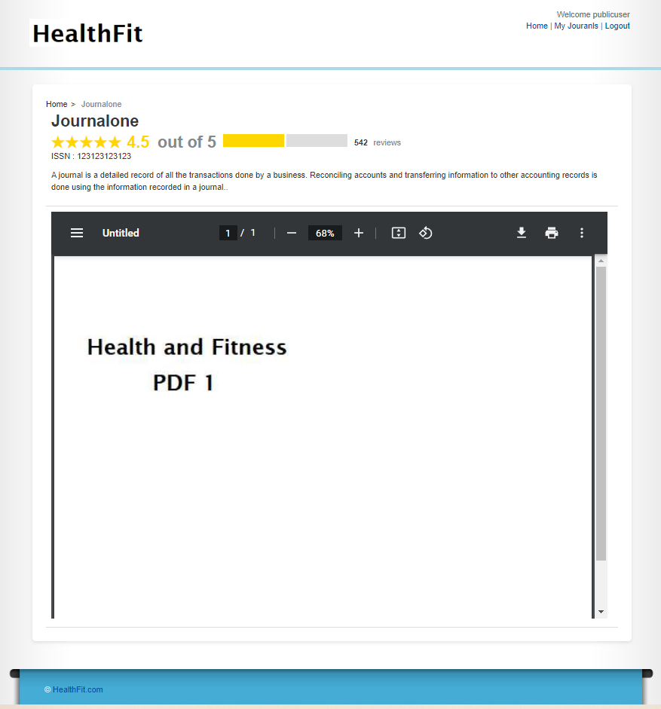
Publisher/User ->
View Jornals

Slide 16

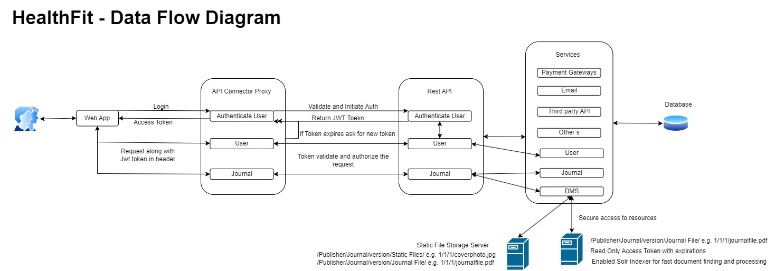
Architecture

Slide 17
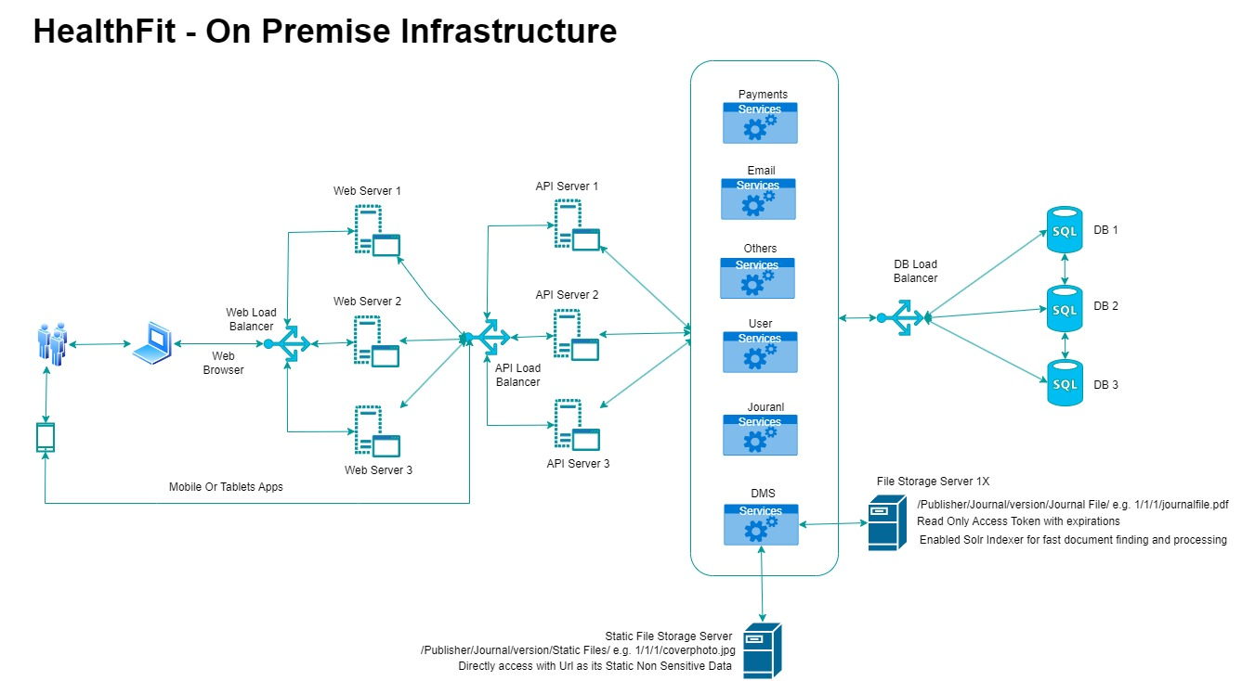
Architecture

Slide 18
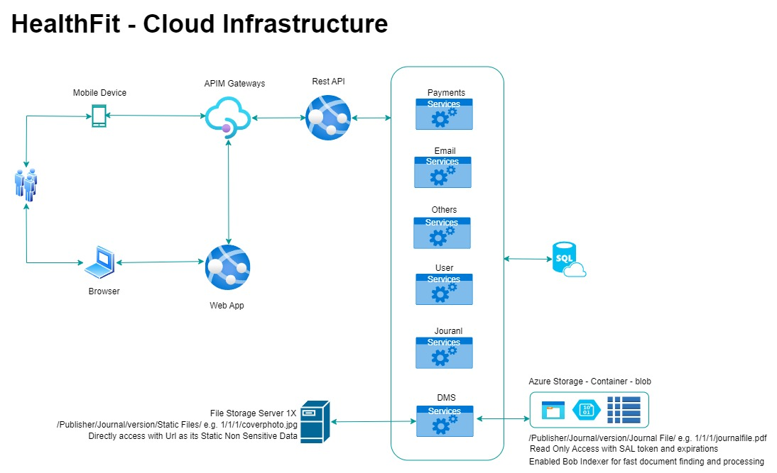
Architecture

Slide 19

Future Scope
Performance and Load test standards
Solr/Elastic engine to index the file for fast retrieval
File can ready by page
File Content – Security Policy e.g. Content Encryption over network
File Content – Malware Scan
File Content – Copyright Policy
Restrict misuse of file – Password protected
Distributed File Storage Servers
Static Code Analyzer
Application Security and Monitoring e.g. Application Insight
Firewall and DDoS Protection of File Servers and many more

Slide 20

Project Components (Code Walkthrough)

Slide 21
Questions ?

Slide 22
Thank You !!!

